Slide 1
BRIDGINGAPPS
Bridging the gap between technology and people with disabilities
Notes:
Tara

Slide 2
Mobile Technology for All Abilities
By Cristen Carson Reat
Co-Founder & Program Director, BridgingApps
A program of Easter Seals Greater Houston
Notes:
Cristen
We try to live this mission every day by:
In-person trainings, presentations like this one, how-to videos, self-paced courses, monthly trainings and meetings, creating and sharing app lists, help desk, success stories, new tech products or diy solutions, AT evaluations and access to 3 AT labs
App search tool to find solutions quickly without wasting time Google searching or iTunes searching
“Getting Started with iPad for Special Needs” book online free
Professionals such as special ed teachers, occupational therapists, speech therapists, assistive technology professionals, educational technology professionals, physical therapists, dietitian, psychologist use apps in their professions and write our reviews. All apps must be trialed with someone who has a disability before a review is written. They are high quality.
3 Assistive Technology labs in the area, free for the community to access. Each has mobile devices and apps with accessories and cases, etc. to try. Locations are The Woodlands, Bellaire, and Stafford Lab.

Slide 3
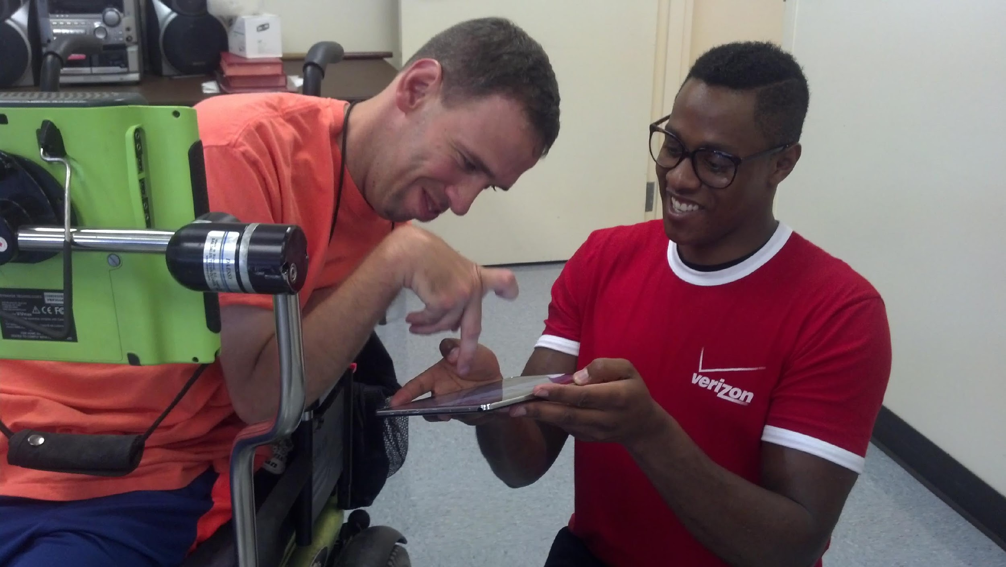
BridgingApps uses low cost, touch-based mobile technologies to
help people with disabilities
REACH
THEIR
FULLEST
POTENTIAL
Notes:
Cristen
We have seen at BridgingApps that using a mobile device can be a life-changing experience.
We have seen devices paired with appropriate apps help someone who is non-verbal communicate, someone who has executive function difficulties express themselves and be more organized and a student with visual issues. Share video by clicking on linking (Proloque2Go) https://www.youtube.com/watch?v=JCrxhiAbHKQ
This low cost commercially available technology that we sometimes take for granted can be powerful Assistive Tech for people of all ages with disabilities.
It allows children to reach therapeutic goals faster, it can assist students produce academic work like their non-disabled peers, and it can allow people of all ages to be more independent.

Slide 4
MISSION
Bridging the gap between technology and people with disabilities
Training & Education
Website tools and Resources
iPad for Special Needs Book
App Reviews in a Special Needs Context
AT Labs
Notes:
Cristen
We try to live this mission every day by:
In-person trainings, presentations like this one, how-to videos, self-paced courses, monthly trainings and meetings, creating and sharing app lists, help desk, success stories, new tech products or diy solutions, AT evaluations and access to 3 AT labs
App search tool to find solutions quickly without wasting time Google searching or iTunes searching
“Getting Started with iPad for Special Needs” book online free
Professionals such as special ed teachers, occupational therapists, speech therapists, assistive technology professionals, educational technology professionals, physical therapists, dietitian, psychologist use apps in their professions and write our reviews. All apps must be trialed with someone who has a disability before a review is written. They are high quality.
3 Assistive Technology labs in the area, free for the community to access. Each has mobile devices and apps with accessories and cases, etc. to try. Locations are The Woodlands, Bellaire, and Stafford Lab.

Slide 5
WWW.BRIDGINGAPPS.ORG
Consider BridgingApps a shortcut for finding apps for special needs:
Getting Started
App reviews and lists
Success Stories
Hardware and Accessories
Programs and Trainings
Community Support Groups
Notes:
Tara
Becoming a member of our site, signs you up for our weekly newsletter which will be delivered to your inbox weekly! Each week we share new app reviews, hardware, upcoming events, and local meeting updates.
Explore an app review and how to search for an app.
Look up Notes:
Narrow by Skill: Categorization
Give time to use search tool

Slide 6
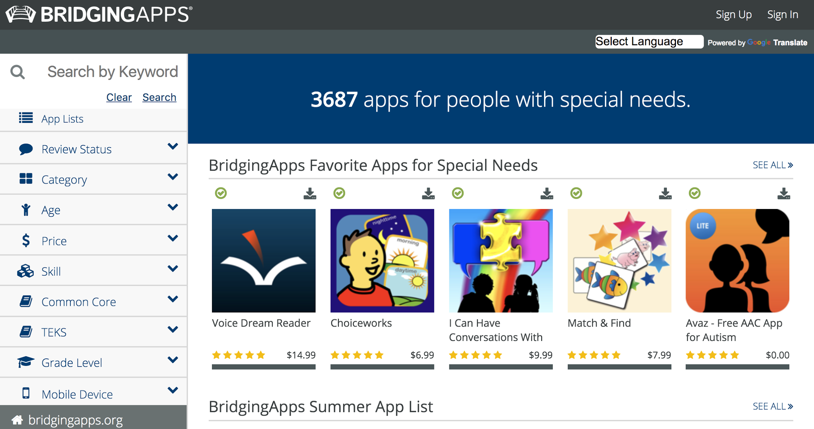
ACCESS & TRAINING

Slide 7
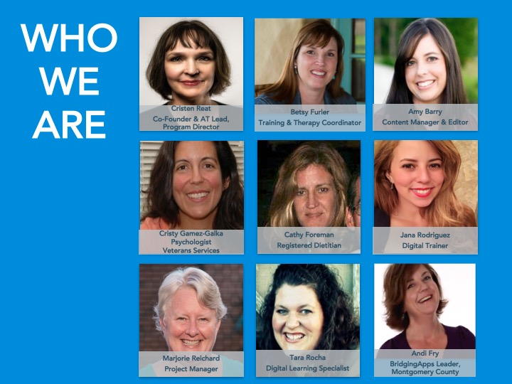
WHO
WE
ARE
Cristen Reat
Co-Founder & AT Lead, Program Director
Betsy Furler
Training & Therapy Coordinator
Amy Barry
Content Manager & Editor
A community of parents,
therapists, doctors,
teachers, AT professionals
and people with disabilities
who share information
on how we are using
mobile devices such as
the iPad, iPhone, iPod
Touch and Android devices
with people who have
special needs.
Cristy Gamez-Galka
Psychologist
Veterans Services
Cathy Foreman
Registered Dietitian
Jana Rodriguez
Digital Trainer
Marjorie Reichard
Special Programs
Tara Rocha
Digital Learning Specialist
Andi Fry
BridgingApps Leader, Montgomery County

Slide 8
Established local meetings
Website Development
Joined Easter Seal
3 AT Labs
2011
s
App Search Tool
App Review Curriculum
Assistive Technology Lab
2012
Expanded Services/Training Programs
TCEA Webinar Series
Expanded Assistive Technology Labs
2013
3600+ apps in Database
Verizon Powerful Answers Award Winner
Opened Ft. Worth Local Meeting
Partnered with Texas Children’s
2014
App Search Tool Upgrade
Mapped Apps to CCSS/TEKS
Launched Seniors Project
2015
Grant awarded for Family Transition Tool
United Healthcare project launched
Grant awarded to serve veterans & families
Weekly Podcast
2016
Helped Harvey survivors access assistive tech
Launched healthy eating behaviors project with Amerigroup
Upgraded App Search Tool to meet accessibility standards
2017

Slide 9
SUCCESS STORIES

Slide 10
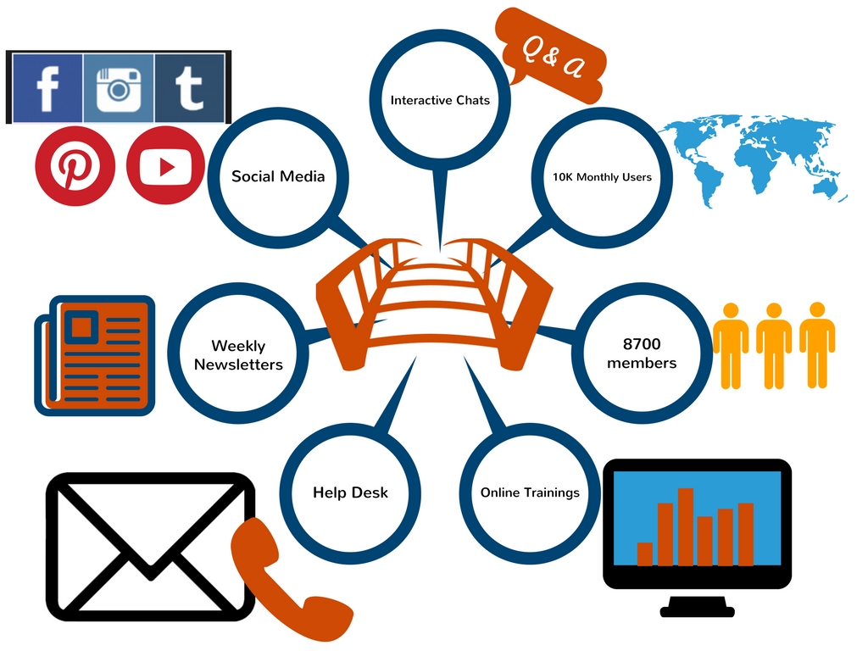
ONLINE IMPACT
Notes:
Tara
Over 8700 Members
10K Monthly Users on our website
Facebook (link), Twitter (link), Pinterest (link), Podcast, Google Hangouts (link), Weekly Newsletter (link)
Online training (link)
Help Desk (link)
Interactive Chats: Twitter Chats, Google Hangouts (link), Facebook Forums with frequently asked questions, Podcasts

Slide 11
COLLABORATORS
SXSW
TIRR
.
Baylor

Slide 12
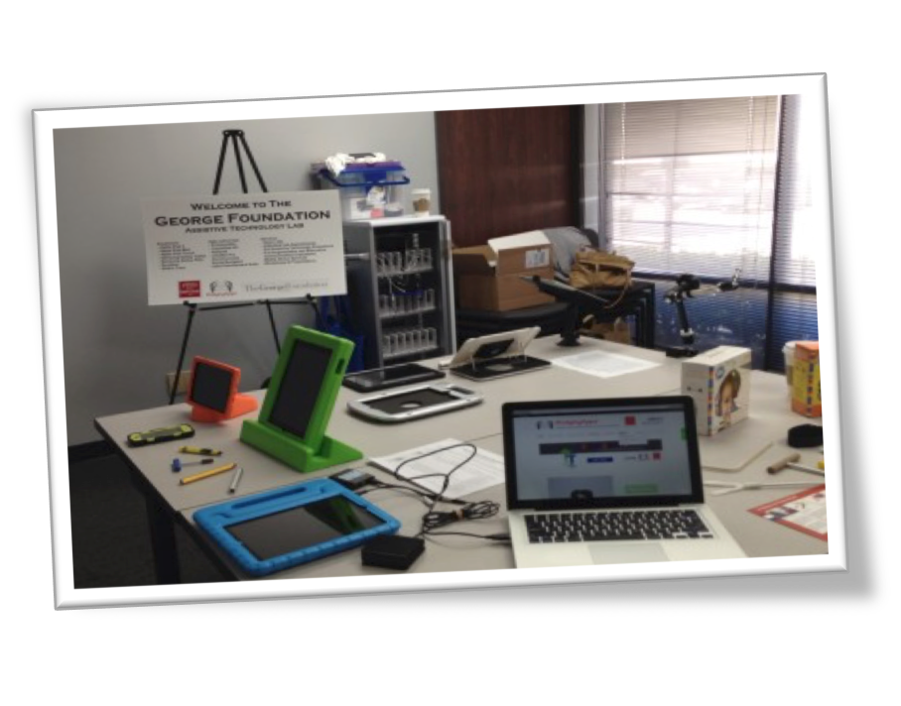
BridgingApps on the Road
Three Locations within the Houston area
We have weekly open lab hours where families, therapists, & teachers can come without an appointment for hands on experience & try devices and applications.
We will also COME TO YOU!
You can try out devices, accessories, apps, learn more about how to search for apps, and join our growing community. Please don’t forget about this FREE resource as you are planning your next staff development!

Slide 13
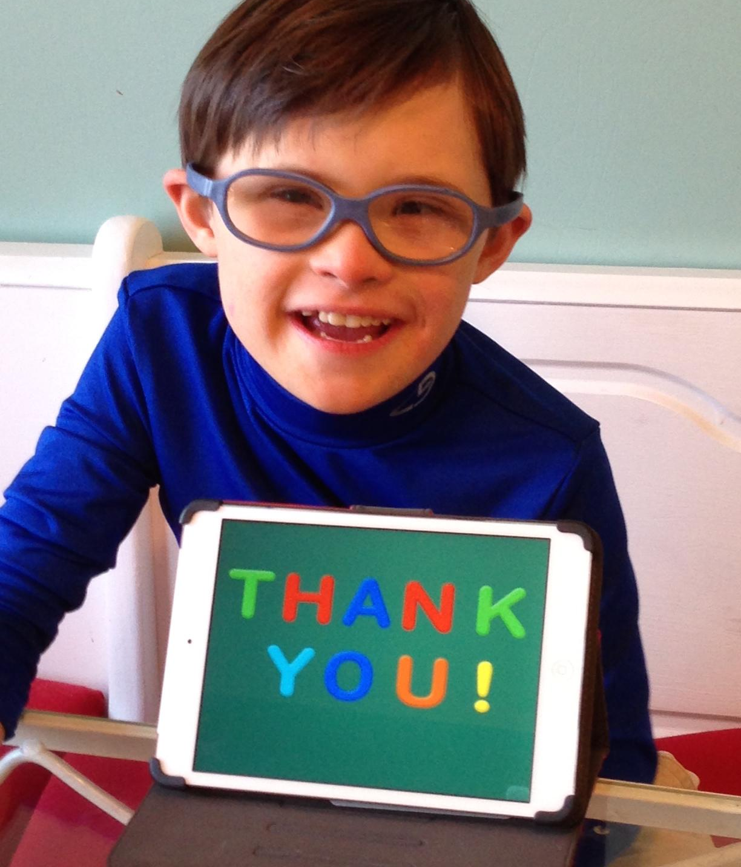
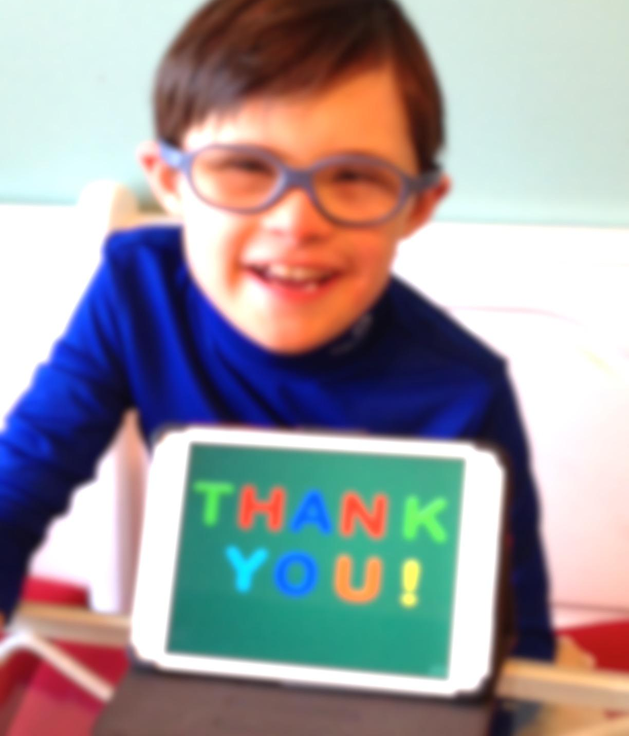

Slide 14
APPS FOR INDEPENDENCE
EasyPhone Flip Writer AAC
CanTunes Waze Navigation
iDress for Weather Voice Dream Reader
SnapType Pro Calm
Pillboxie One-Moment Meditation
Carezone Pandora Music
Caresync
Seizure Log
Choiceworks
Choiceworks Calendar

Slide 15
THANK YOU
CRISTEN REAT EASTER SEALS GREATER HOUSTON CREAT@EASTERSEALSHOUSTON.ORG │WWW.BRIDGINGAPPS.ORG│713-838-9050 4888 Loop Central Drive Ste. 200 │HOUSTON, TX 77081

